Slide 1
UCSD Embedded RTOS Assignment 5
By
Hsuankai Chang
hsuankac@umich.edu

Slide 2
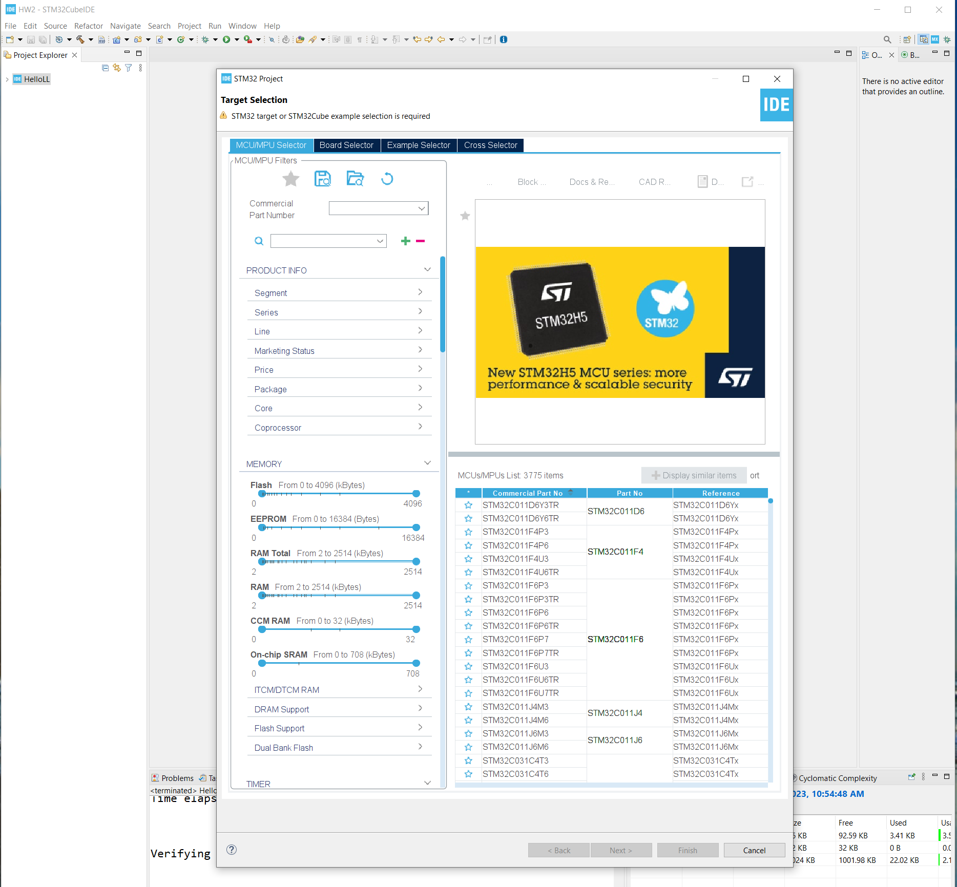
Step 1. Startup STM32CubeIDE and create new STM32 project

Slide 3
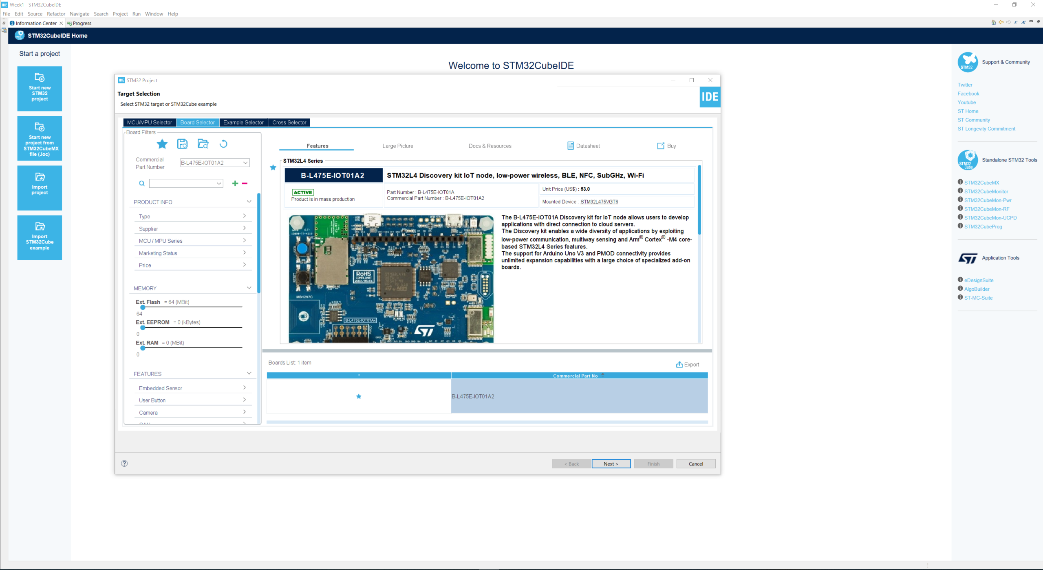
Step 2. Access board selector and type in the board you use, click Next

Slide 4
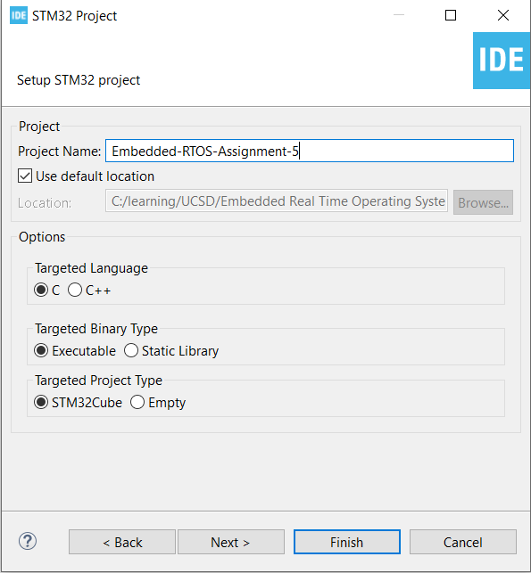
Step 3. Enter the project name then click Next

Slide 5
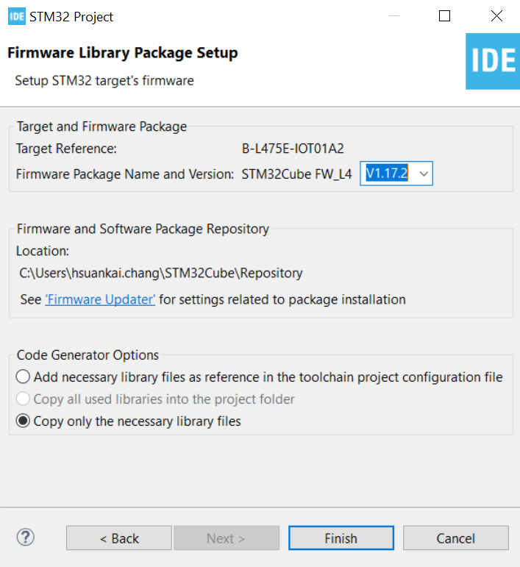
Step 4. See the firmware package name and version

Slide 6
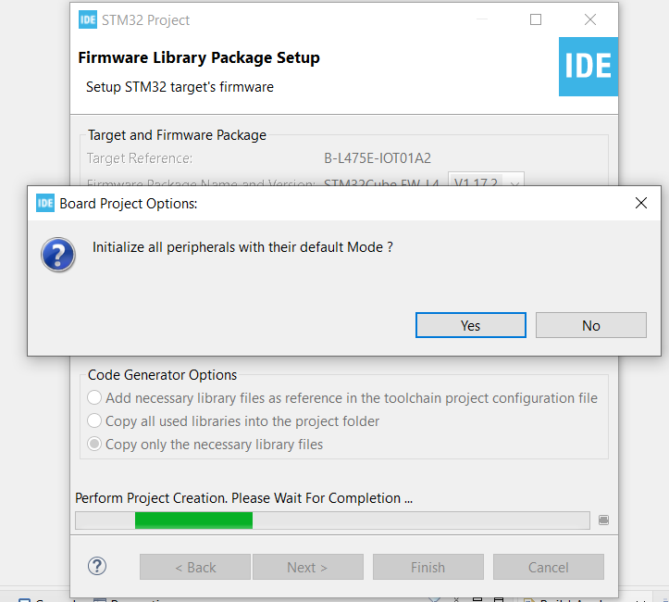
Step 5. Click yes to initialize all peripherals to default

Slide 7
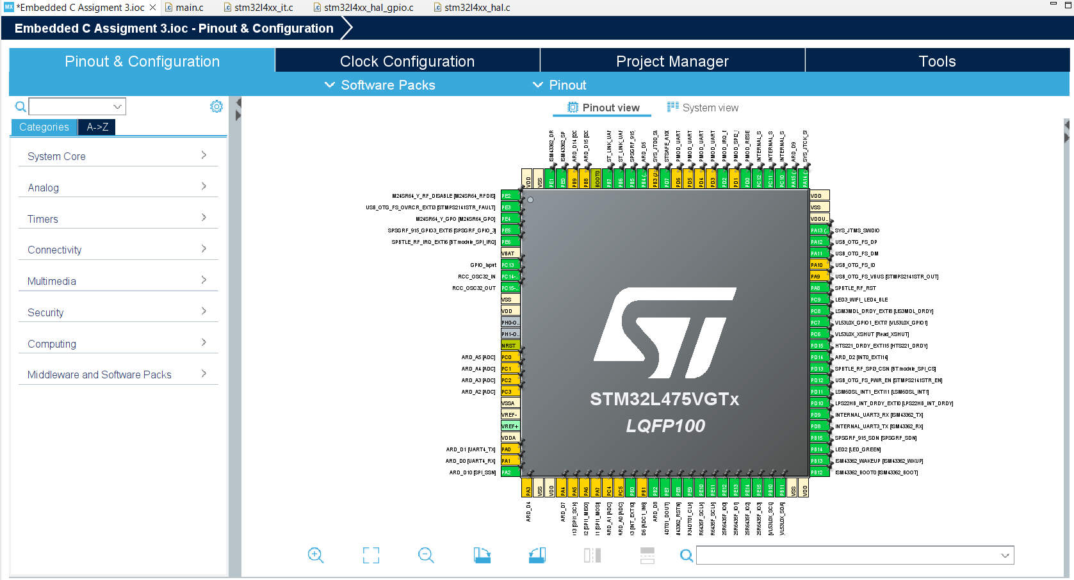
Step 6. When in .ioc file, click Pinout & Configurations

Slide 8
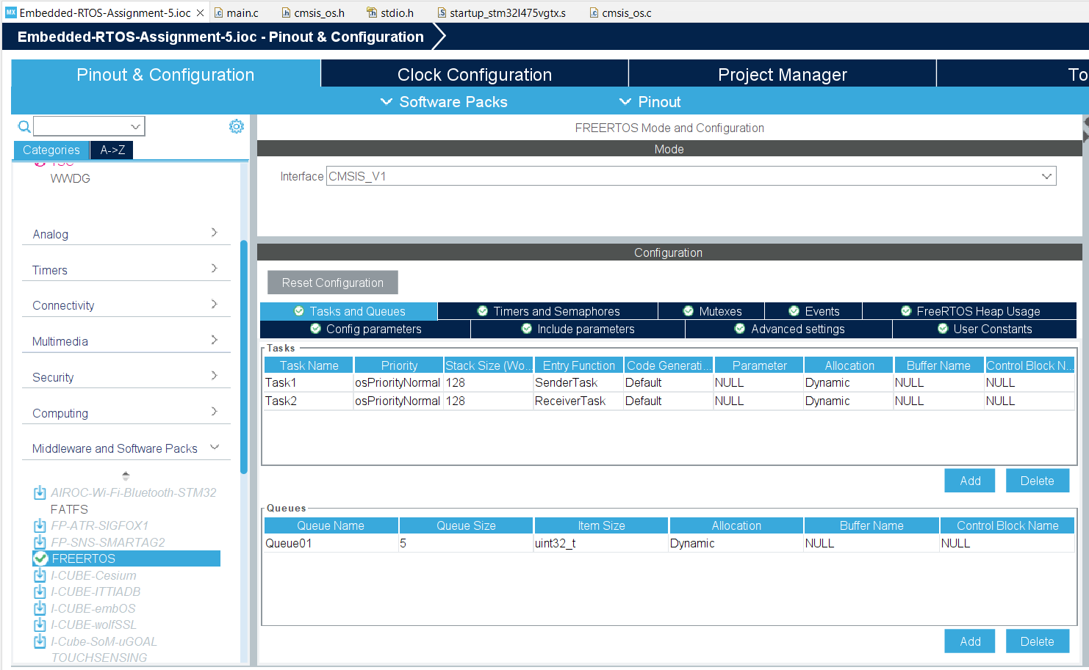
Step 7. Enable the CMSIS_V1 RTOS, and create sender, receiver tasks. Also create a queue with 5 uint32_t elements.

Slide 9
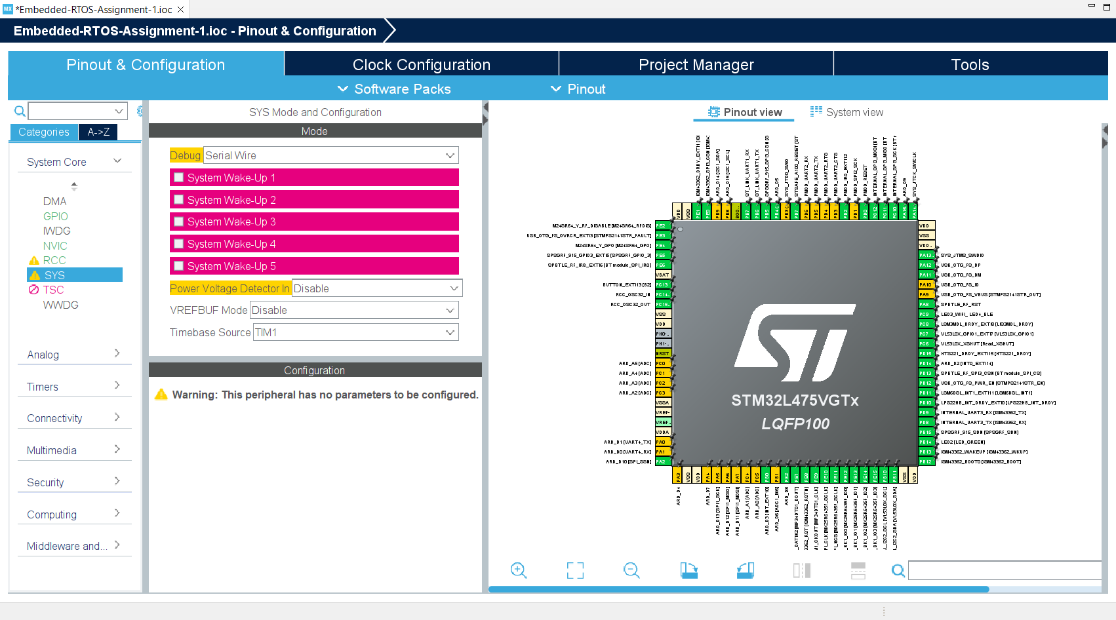
Step 8. Change Timebase from systick to TIM1

Slide 10
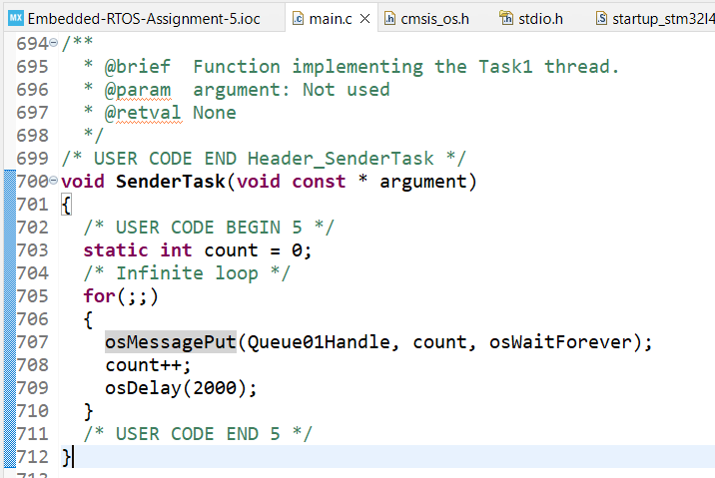
Step 9. Code the sender task, I use CMSIS-RTOS API

Slide 11
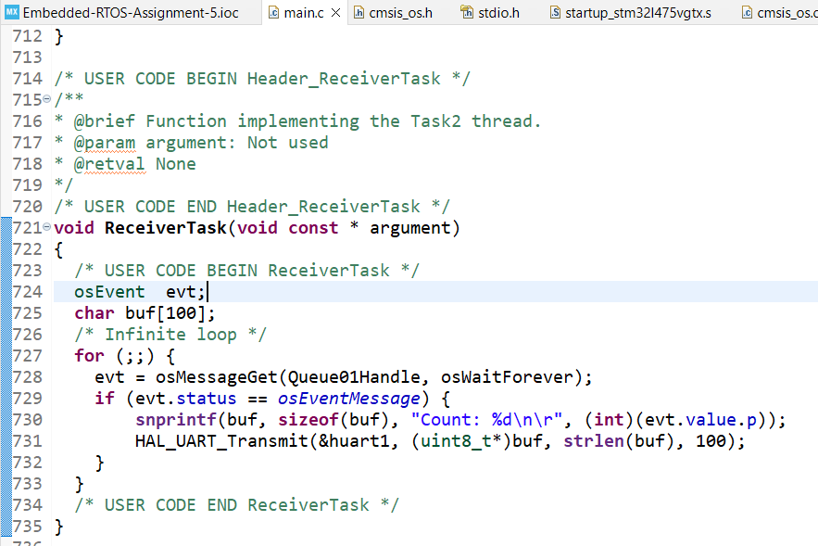
Step 10. Code the receiver task

Slide 12
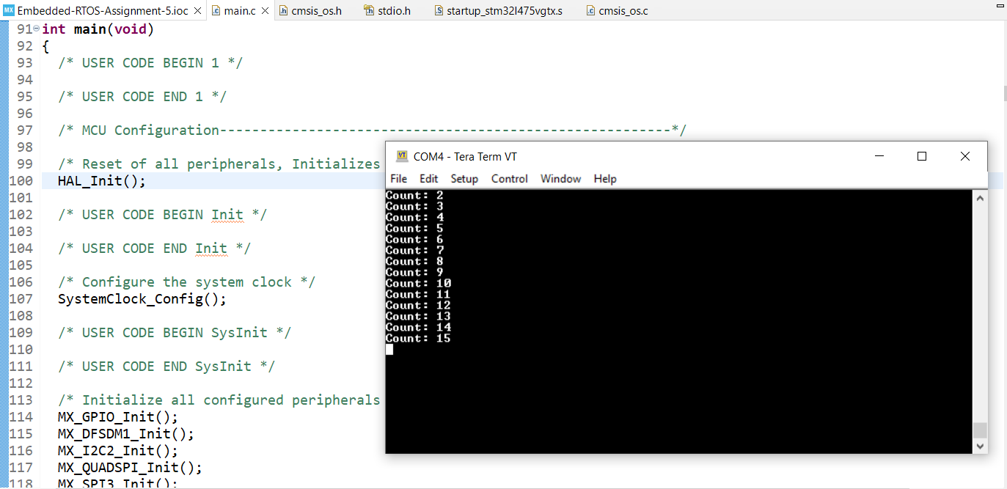
Step 11. Compile and run the code, test is successful

